Slide 1
Inflation

Slide 2
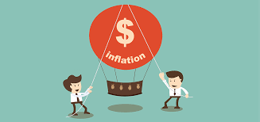
Meaning of inflation
In economics, inflation is a rise in the general level of prices of goods and services in economy over a period of time. When the general level of prices rises, each unit of currency buys fewer goods and services.

Slide 3
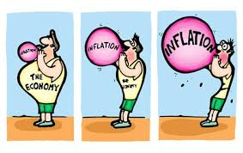
Measuring inflation
The gross domestic product deflator measures the aggregate prices of all goods and services produced by the entire nation encompassing the CPI and the PPI statistics. The CPI is a sound index to measure inflation, but for a more accurate and comprehensive measure, the PPI and the GDP deflator are also required.

Slide 4
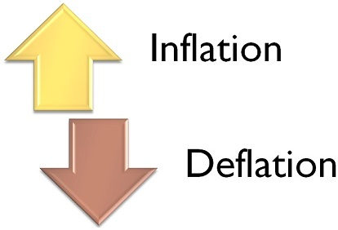
Inflation vs. defilation
While inflation represents an overall upward price movement of goods and services, deflation acts adversely.

Slide 5
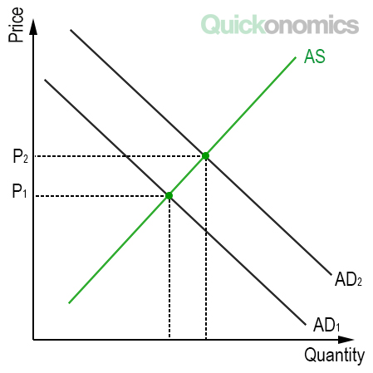
Types of inflation
Open inflation
Suppressed inflation
War-time inflation
Peace time inflation
Sectoral inflation
Comprehensive inflation

Slide 6
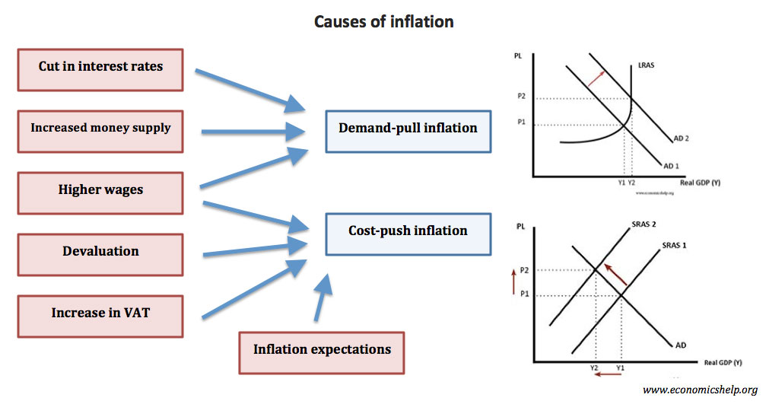
Causes of inflation
Demand-pull inflation
Cost-push inflation
Built-in inflation

Slide 7
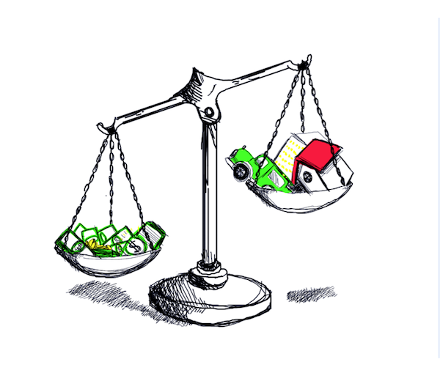
Effects of inflation
Investment
Interest rates
Exchange rates
Unemployment
Stocks
Decrease in the purchasing power
Change in the allocation of income

